Slide 1
“Human activity is the cause of rising land and sea temperatures”
Hypothesis
Man Kit Yip

Slide 2
contents
Content | Slide
A. Rise in global temperatures 1880-2015 | 3
B. Rise in CO₂ emissions over past two decades | 4
C. Correlation between rise in temperatures and CO₂ emissions | 5
D. Conclusions | 6
E. Areas for further exploration | 7
F. Questions | 8

Slide 3
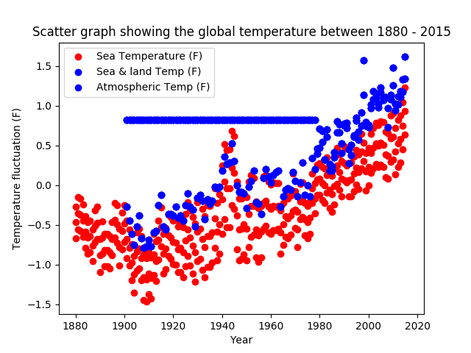
A. Rise in global temperatures 1880-2015
Steadily rising trend over the past 140 years
Progressively higher highs and lows
Interpolated data was used to deduct the mean temperature fluctuation between 1901 and 1978

Slide 4
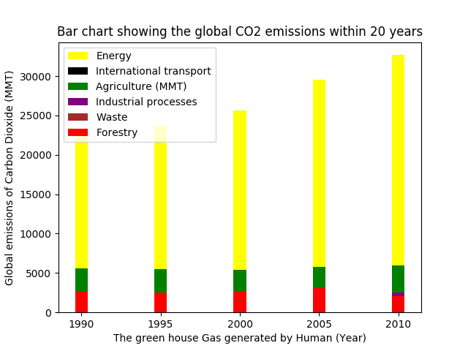
B. Rise in C0₂ emissions over past two decades
Steady increases in CO2 emissions during examined period
Increase in energy demands led to increase in the greenhouse gas production
Proportion of other sources of CO2 emissions remains unchanged

Slide 5
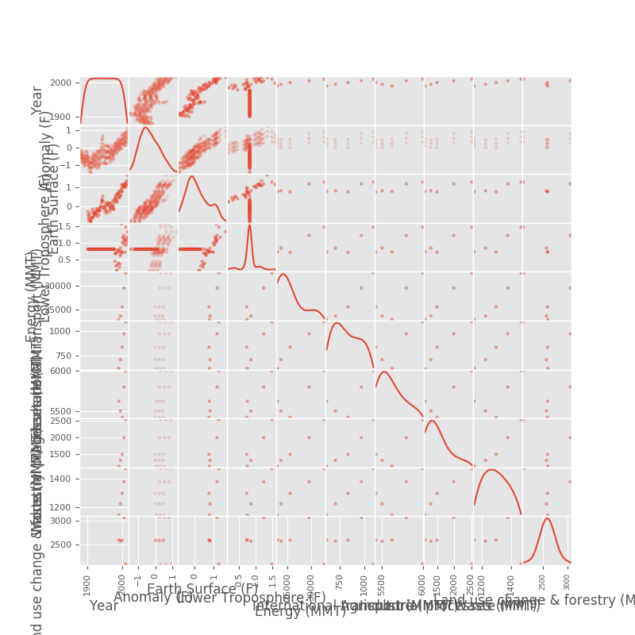
C. Correlation between rise in temperature and c0₂ emissions

Slide 6
D. conclusion
Strong positive correlation between (a) anomaly in temperature/ global (sea, land, atmospheric) temperature and (b) chronological progression
Insufficient data set on global CO2 emissions means its correlation with anomaly in temperature & global temperature is inconclusive

Slide 7
e. Areas for further exploration
Address incomplete data sets on both historical land, sea and atmospheric global temperature, and CO2 emissions
Explore potential work-arounds to enrich the limited variety and veracity of data set by mining public databases
Research into the factors which may explain the correlation of the trend in rising global temperature and greenhouse gases

Slide 8


F. questions?

